Slide 1
Optimizing Pizza Business: Order and Revenue Insights
Leveraging SQL for Insights

Slide 2
Introduction :
Analyzing sales data of a pizza store using SQL queries.
Highlight the importance of data analysis in understanding customer preferences and optimizing business operations.

Slide 3


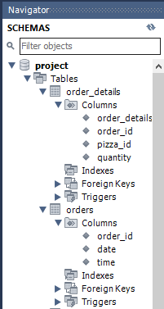
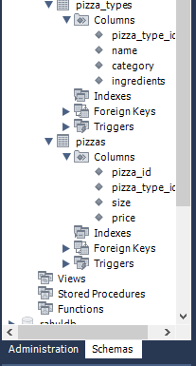
Data Exploration
Orders details
Orders
Pizza types
Raw CSV
Files
Pizzas
Cleaned & Imported Data

Slide 4
FUNDAMENTAL
ANALYSIS
RESTAURANT
SALES
Index
Retrieve the total number of orders placed.
Total revenue generated from pizza sales.
Category wise distribution of pizza.
Identify the highest-priced pizza.
Identify the most common pizza size ordered.
List the top 5 most ordered pizza types along with their quantities.

Slide 5
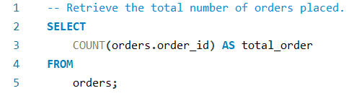

Total Order placed
SQL Query
Result

Slide 6
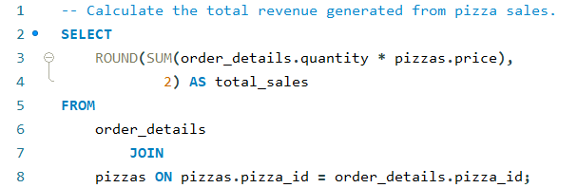

Total Revenue Generated
SQL Query
Result

Slide 7
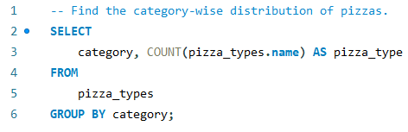

Pizza distribution: Category wise
SQL Query
Result

Slide 8
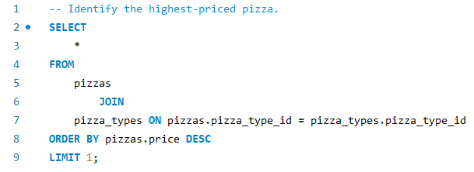
Highest Priced Pizza
SQL Query
Result

Slide 9
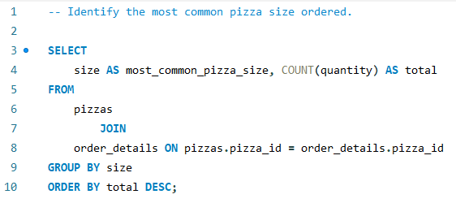
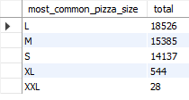
Most Common Pizza Ordered
SQL Query
Result

Slide 10
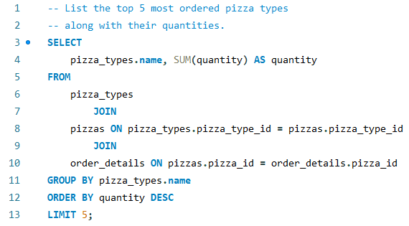
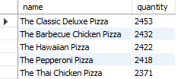
Top 5 Pizza Ordered
SQL Query
Result

Slide 11
INTERMIDIATE
ANALYSIS
RESTAURANT
SALES
Index
Total quantity of each pizza category ordered.
Pizza Order per hour of a day.
Average number of pizzas ordered per day.
Top 3 most ordered pizzas based on revenue.

Slide 12
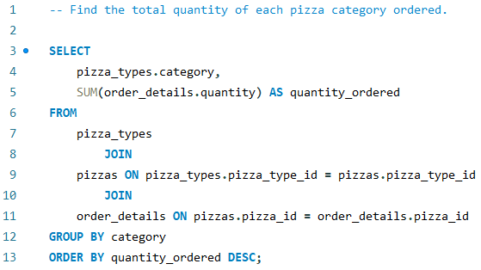

Sale By Each Pizza Category
SQL Query
Result

Slide 13
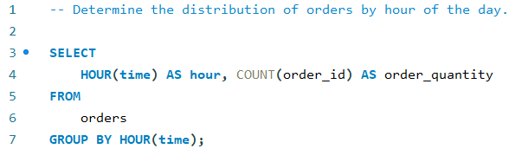
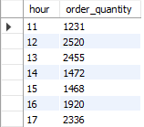
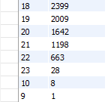
Sales By Hour of the Day
SQL Query
Result

Slide 14
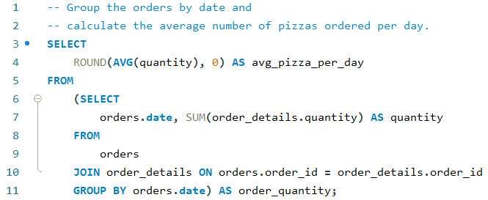

Average Pizza Ordered Per Day
SQL Query
Result

Slide 15
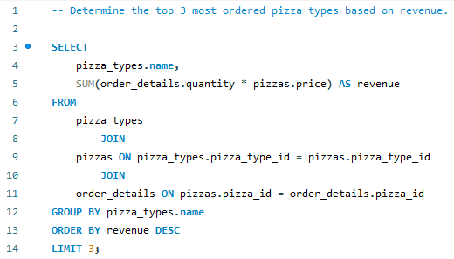

Top 3 Most Ordered Pizza
Based on Revenue
SQL Query
Result

Slide 16
ADVANCE
ANALYSIS
RESTAURANT
SALES
Index
Contribution of each pizza to total revenue.
Cumulative revenue generated over time.
Top 3 most ordered pizza based on revenue for each pizza category.

Slide 17
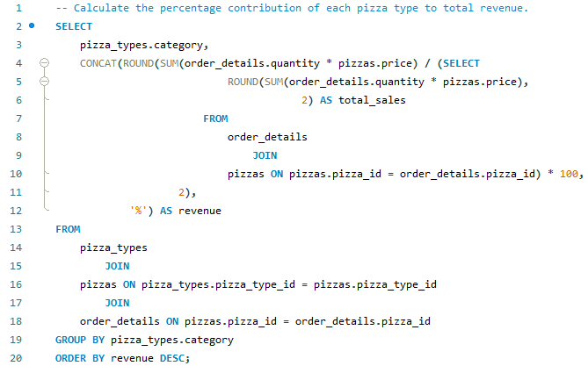

Contribution of Each Pizza to Total Revenue
SQL Query
Result

Slide 18
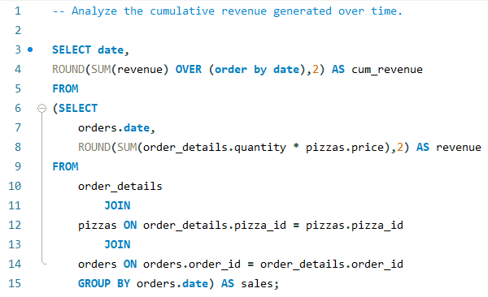
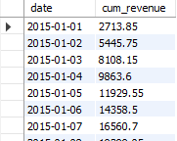
Cumulative Revenue Generated Over Time
SQL Query
Result

Slide 19
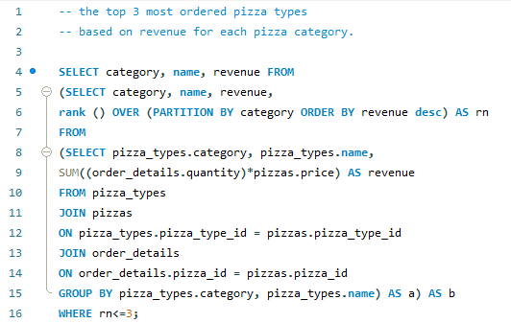
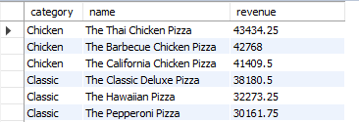
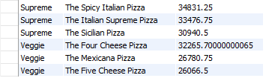
Top 3 Most Ordered Pizza Based on Revenue for Each Category.
SQL Query
Result

Slide 20
THANK YOU

